Slide 1
04. Cloud monitoring & management

Slide 2
4.1] cloud service provider & users : -
Cloud Service Providers (CSP) provides on-demand cloud based services like computing power, data storage or applications over the internet.
CSP offers these services to the user, and user can choose a CSP based on their needs and the services offered.
Instead of building your own infrastructure for services, you can rent services from a cloud service provider.
For Example- Amazon Web Services (AWS), Microsoft Azure, Google Cloud Platform, IBM Cloud Services, etc.
1. IaaS Service Provider : -
i) Amazon Web Service (AWS).
ii) Microsoft Azure.
iii) Google Cloud Platform (GCP).
2. PaaS Service Provider : -
i) Heroku.
ii) Google App Engine.
3. SaaS Service Provider : -
i) Google Workspace.

Slide 3
Users : -
The 'user' in context of CSP is a person, group or entity who utilizes the CSPS services and resources.
The platform of the CSP is used by the users to access and make use of a variety of cloud services including computing capacity, storage, networking & software applications.
Cloud service users are as Follows : -
1. Individuals.
2. Small Businesses.
3. Large Enterprises.
4. Developers.
5. Eductional Institutions.
6. Government Agencies.

Slide 4
4.2] Architecture of Federated Cloud Computing : -
Federated Cloud Computing is an advanced cloud model where multiple independent cloud service providers collaborate to share resources, services, and infrastructures.
The main objective of this architecture is to overcome the limitations of a single cloud provider, such as resource shortage, geographic restrictions, or service unavailability.
The architecture of federated cloud computing consists of several key components that work together to ensure interoperability, scalability, and efficient resource utilization across multiple clouds.

Slide 5
1. Cloud Providers : - These are independent cloud service providers (public or private) that contribute computing resources such as storage, processing power, or applications to the federation.
2. Cloud Broker : - The broker acts as an intermediary between the user and multiple cloud providers. It helps in selecting the best provider based on parameters like cost, performance and availability.
3. Cloud Coordinator (Manager) : - Each cloud in the federation has a coordinator responsible for managing local resources and handling communication with other clouds in the federation.
4. Cloud Exchange (Marketplace) : - The exchange acts as a trading platform where cloud providers publish their available resources and users or brokers can negotiate for the best deal.
5. Federation Manager : - This component is responsible for maintaining agreements and policies between the participating clouds. It ensures trust, authentication, and resource sharing according to defined service-level agreements (SLAs).
6. Users or Clients : - End-users submit their application or service requests to the federated system. The system automatically allocates resources from the best available cloud provider(s).

Slide 6
4.3] service level agreement (sla) : -
A Service Level Agreement (SLA) is a formal contract between a service provider and a customer that defines the expected level of service.
It specifies measurable performance metrics, responsibilities, and guarantees regarding service quality, availability, and responsiveness.
SLA Management refers to the process of creating, monitoring, and maintaining these agreements to ensure that both parties meet their commitments.
It plays a crucial role in cloud computing, networking, and IT service management by ensuring transparency and accountability between users and service providers.

Slide 7
sla management : -
A service level Agreement (SLA) is the bond for performance negotiated between the cloud services provider of clients.
SLA provides a framework within which both seller an buyer of a service can pursue a profitable service business relationship.
It set expectations and responsiblities of both involved parties.
• Types of SLA:
1) Customer-based SLA.
2) service-based SLA.
3) Multilevel SLA.

Slide 8
1. Customer-level sla : -
An agreement that covers all the services used by a individual customer.
It can include details on service availability, responsible, procedures and cancellation terms.
The services also differ with each customer so the service provider makes a unique SLA for each customer.
A telecom company may have a customer-based SLA.

Slide 9
2. Service-level sla : -
A contract that details a service offered to multiple customers.
It standardizes the terms and conditions for all customers who use that service.
A CSP may offer a service-based SLA guaranteeing 99.9% uptime to all its customers.
For ex. An agreement of insurance between a company and its customer.

Slide 10
3. multi-level sla : -
A multi-level SLA divides the agreement into multiple levels, each addressing a different aspects of service.
This type of agreement is suitable for providers with many customers using their product at different price ranges.
It allows user to integrate several conditions into the same system to create a more suitable service.
For ex. An IT service provider may have a corporate-level SLA for all customers, A customer-level SLA for specific document/department needs, and a service-level SLA for distinct services like software support and network maintenance.

Slide 11
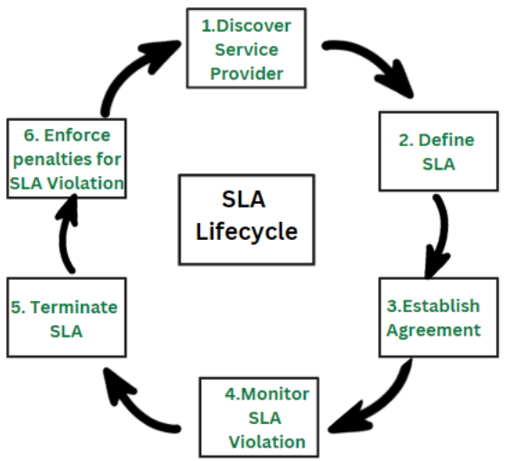
Life cycle of sla : -
1. Discover Service Provider : - This step involves identifying a service provider that can meet the needs of the organization and has the capability to provide the required services.
2. Define SLA : - In this step, the service level requirements are defined and agreed upon between the service provider and the organization.
3. Establish Agreement : - After the service level requirements have been defined, an agreement is established between the organization and the service provider outlining the term and conditions of the service.
4. Monitor SLA Violation : - provider is unable to meet the service level objectives, this step regularly monitoring the service level objectives to ensure that the service provider is meeting their commitments.
5. Terminate SLA : - If the service r if the organization is not satisfied with the service provided, the SLA can be terminated.
6. Enforce penalties for SLA Violation : - If the service provider is found to be in violation of the SLA, Penalties can be imposed as outlined in the agreement.

Slide 12
4.4] service catlog : -
A Service catlog is a centralized list of cloud services that users can browse, request and understand.
It helps organizations manage IT services, ensure compliance and improve visibility into cloud resources.
The purpose is to enable users to easily request services.
Users can self-provision cloud services without going through IT departments.
The service catlog Includes detailed descriptions, pricing and service Level agreements (SLA).

Slide 13
Service management : - i) Cloud service Management refers to the management of data, content and applications in cloud computing. ii) A Managed Service Provider (MSP) can manage these individually or all together iii) Backup and disaster recovery plans are in place to ensure data safety and quick recovery in case of Failures.
Functional Interfaces of services : -
i) It refers to how users or systems interact with a service, typically through user interface (UI) APIs.
ii) Ensures consistent and uniform methods of interacting with services.
iii) Functional interfaces refers to way services are designed to interact with each other.

Slide 14
4.5] cloud portal & its functions : -
It is a web based interface that allows users to access & manage cloud-based services and resources.
Cloud Portals can be private or public. Private portals are build accessed only by a single company / organization, while public portals are accessible by other users on a subscription.
The cloud Portal provides information about the services for which the user has an active subscription.
Examples : -
1. AWS Management console (AWS).
2. Google Cloud console (GCP).
3. Azure Portal (Microsoft Azure).
4. IBM Cloud Console (IBM).

Slide 15
Functions of cloud portal : -
1. Resource Provisioning : -
i) Through this portal, users can provision and configure virtual machines, storage, databases and other cloud resources.
ii) This allows easy scalability and flexibility in managing cloud infrastructure.
2. Monitoring and Analytics : -
i) It provides real time insights and analytics on the performance, usage and health of cloud resources.
ii) You can monitor metrics, track usage and identify areas for optimization and improvement.

Slide 16
3. Security and Access Control : -
i) The portals allow users to set up and manage security measures such as authentication, authorization and encryption.
ii) This ensures the protection of cloud environment and data.
4. Cost Management : -
i) Cloud portal offer features to track and manage your cloud expenses.
ii) You can monitor resource usage, analyze costs and optimize spending to ensure efficient resource allocation.

Slide 17
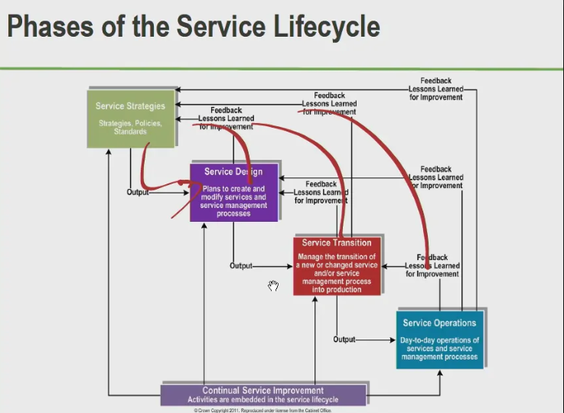
4.6] Cloud Service life cycle phases : -
1. Service Planning / strategy : -
Define business objectives, assess cloud readiness and select the appropriate cloud model.
It includes planning for resource needs, security, and compliance.
2. Service creation / Design : -
Design and build the doud infrastructure or services, including configuration & deployment.
This phase ensures the solution meets the defined requirements.
3. Service Transition : -
Migrate existing services or deploy new ones to the cloud environment.
It involves testing, Haining and addressing any potential disruptions during the transition.

Slide 18
4. Service operation : -
Manage, monitor and optimize the cloud services to ensure performance, availability and security.
Continuous monitoring and scaling occur to meet operational demands.
5. Service Improvement : -
Regularly review the services for performance, cost-efficiently and innovation.
This phase focuses on refining & improving services to adapt to changing needs
6. Service Termination : -
Retire cloud services that are no longer needed or have been replaced.
This includes securely handling data, releasing resources, and ensuring minimal impact on operations.

Slide 19
4.7] cloud resource management : -
Cloud Resource Management is a process of efficiently allocating, scheduling, and controlling cloud computing resources such as CPU, memory, storage, and network bandwidth to meet user requirements and service level agreements (SLAs).
The main goal of resource management is to ensure optimal performance, cost-effectiveness, scalability, and reliability in a cloud environment.
It involves two major phases : -
1. Ab-initio Resource Assignment.
2. Periodic Resource Optimization.

Slide 20
1. ab-initio resource assignment : -
Ab-initio Resource Assignment refers to the initial allocation of resources when a new application, service, or virtual machine (VM) is deployed in the cloud.
It determines how much CPU, memory, and storage will be assigned to each task or user based on initial requirements and workload predictions.
Example : - When a new virtual machine is launched, the cloud management system assigns initial CPU cores, memory, and storage based on the requested instance type.

Slide 21
2. Periodic resource optimization : -
Periodic Resource Optimization is the process of re-evaluating and adjusting resource allocation during runtime to maintain efficiency as workloads change over time.
It ensures continuous performance improvement and energy efficiency in the cloud environment.
Example : - If a VM becomes idle, the system may consolidate its tasks to another machine and power down the idle server to save energy.

